Slide 1
Interaction Styles Lecture 4

Slide 2
Interaction Styles
There are different ways a user can communicate with a computer system and a computer system can communicate with a user. These are called interaction styles.
An interaction style is a collection of user interface controls and their associated behavior. The interaction style provides both the look (appearance) and feel (behavior) of the user interface components, indicating the way a user will communicate with the system..
There are several interaction styles from which a designer can choose:
Command line
Menu selection
Form-fill
Direct manipulation
Anthropomorphic

Slide 3
Command Line
The choice of interaction style will also depend on the choice of interaction devices (both input and output devices), and vice versa.
The Command Line Interface (CLI) was the first interactive dialog style to be commonly used.
Using function keys on a keyboard (F1, F8, etc.), single characters, abbreviations, or whole-word commands.
Command line interfaces are powerful because they offer access to system functionality.
They are also flexible: the command often has a number of options or parameters that will vary its behavior in some way. This flexibility and power, as we will discuss, is difficult to learn to use.

Slide 4
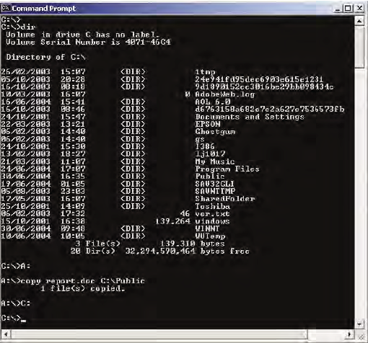
Command Line

Slide 5
Guidelines for Designing (CLI)
Command line interfaces are better for expert users than for novices. However, error rates are typically high, training is necessary.
Choose meaningful commands—use specific and distinctive names.
Follow consistent syntax (grammatical structure) for all commands.
3. Support consistent rules for abbreviation.
4. Give commands a representative (inherent) meaning; for example, use commands such as add, plot, and print.
5. Make commands as short as possible to help prevent entry errors and to facilitate the detection and correction of errors.
6. If commands or responses to commands can be abbreviated, use common abbreviations, for example Y for yes and N for no.

Slide 6
Guidelines for Designing (CLI)
7. Limit the number of commands and ways of accomplishing a task.
8. Offer frequent users the capability to create macros. A macro is a set of commands that can be called by a name to be executed in one step; they are useful for combining commands that are to be performed in a strict sequence. The use of macros saves typing effort and means that the user does not have to memorize long command sequences.

Slide 7
Menu Selection
Menu selection avoids many of the problems associated with command line interfaces. A menu is a set of options from which the user must choose.
Menus are effective because they offer cues for user recognition rather than forcing the users to recall the syntax of a command from memory
Menu selection can be rapid and accurate.
Users have little training

Slide 8
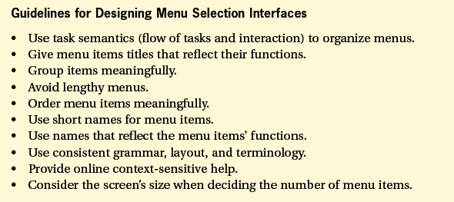
Guidelines for Designing Menu

Slide 9
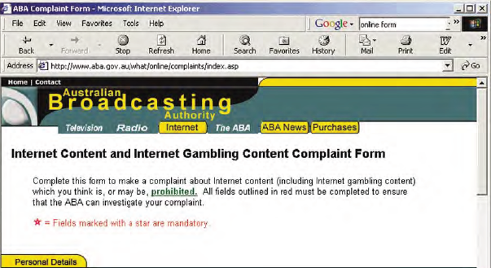
Form-Fill
If your interface has to gather a lot of information from the user, then it often helps if you provide a form to fill in. An example is the web page;

Slide 10
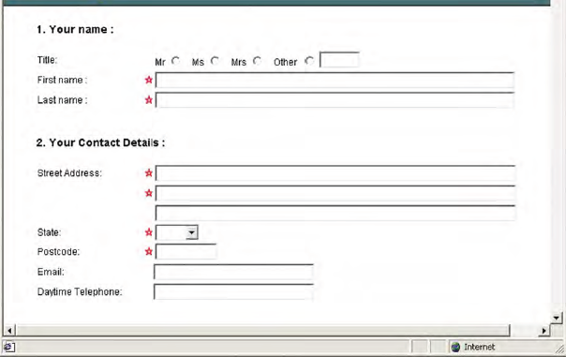
Form-Fill

Slide 11
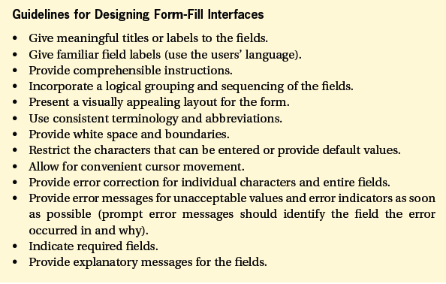
Guidelines for Designing Form-Fill

Slide 12
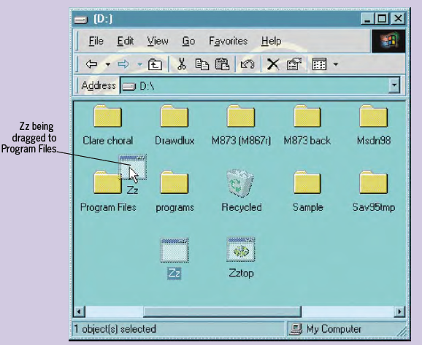
Direct Manipulation (DM)
Direct manipulation interfaces allow users to interact directly with the UI objects.
For example, dragging a file from one folder and dropping it into another, as illustrated in following Figure

Slide 13
Direct Manipulation (DM)
In DM interfaces, the keyboard entry of commands or menu choices is replaced by manipulating a visible set of objects and actions. This is usually achieved by using a continuous input device, such as a mouse, pen, or joystick.
DM interfaces exist in many application areas, including word processing, desktop publishing, computer-aided design (CAD), flight simulation, virtual reality systems, and video games. Most word processors are DM interfaces, also called WYSIWYG (what you see is what you get) word processors.

Slide 14
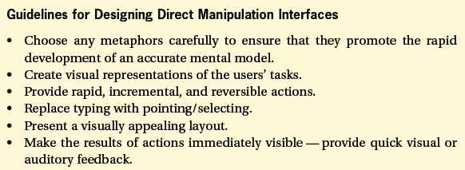
Guidelines for Designing DM

Slide 15
Anthropomorphic
Anthropomorphic interfaces aim to interact with users in the same way that humans interact with each other. Natural language interfaces and interfaces that recognize gestures, facial expressions, or eye movements all belong to this category.
There are three main ways of entering natural language:
speech, handwriting, and typing. For all three, a system needs to be able to cope with vagueness, ambiguity, and ungrammatical constructions
Blending Interaction Styles
Most modern UIs blend more than one interaction style. This is true of Windows and most other GUIs.

Slide 16
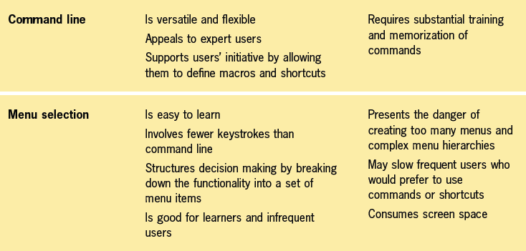
Adv. &Disadv. of Interaction Styles

Slide 17
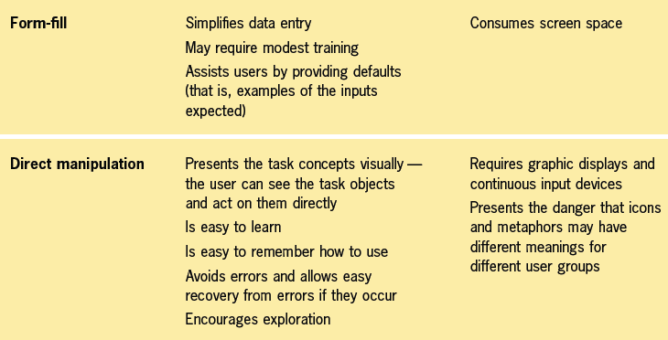
Adv. &Disadv. of Interaction Styles

Slide 18

Adv. &Disadv. of Interaction Styles

Slide 19
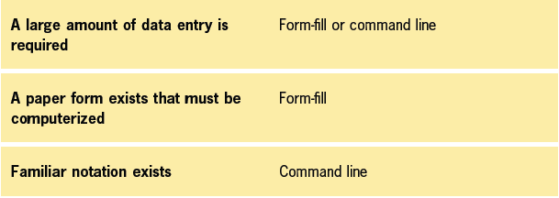
Task Characteristics & Interaction Style

Slide 20
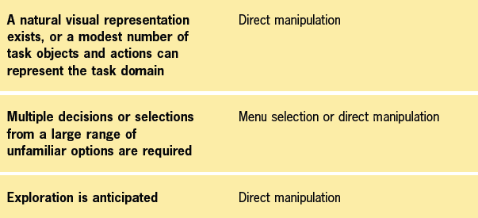
Task Characteristics & Interaction Style

Slide 21
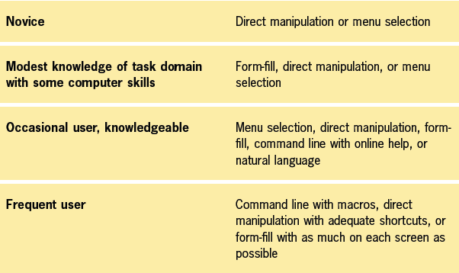
User’s Characteristics & Interaction Style

Slide 22
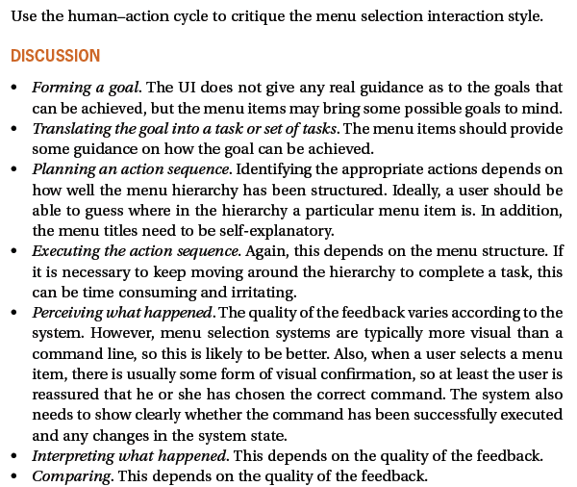
EXERCISE

Slide 23
THANKS

